Slide 1
Data Science with Python
Summer 2016

Slide 2
Today
Hello
Data Science: what is it?
Course Overview
Python: check-in on codeacademy
Data Ingestion
Jupyter / ipython
Git / VirtualEnv
Check-in

Slide 3
What is Data Science?
What words come to mind when you think of Data Science?
What experience do you have with Data Science?
Why are you taking an Introduction to Data Science Class?

Slide 4
“Data”

Slide 9
^{Cities}
^{Infrastructure}
^{Industrial}
^{Family Assets}
^{Smart Appliances}
^{Personal Devices}

Slide 10
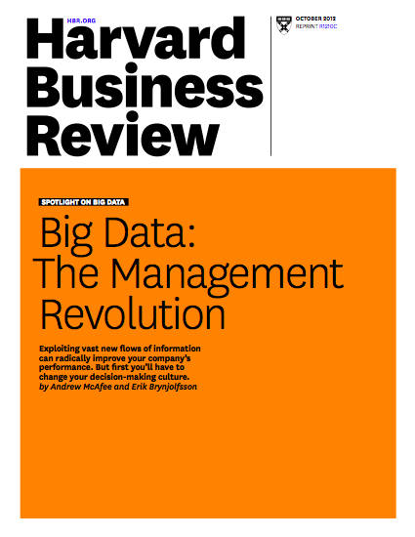

Slide 11
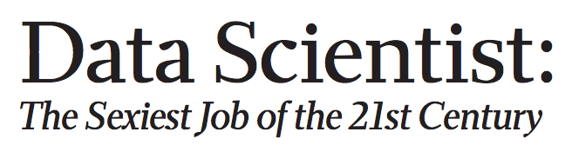

Slide 12



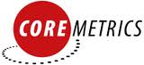







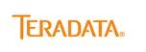

















Slide 13
Consumer data landscape
A framework for understanging consumer data
Digital Offline
Recognition
Targeting
Measurement
Name / Address
Demographics
Life Stage Changes
Household
Offline Behaviors
POS & Transactions
Phone
Interest / Lifestyle
Email
Propensities
Industry Channel Data
Viewership
Device
Location
OBA
Conversions
IP
Cookies
Non-industry specific
Industry specific
Not outcome predictable
High outcome predictable
Data vendors specialize in different parts of this “consumer data” landscape

Slide 14































Consumer data landscape
A framework for understanging consumer data
Digital Offline
Recognition
Targeting
Measurement
Name / Address
Demographics
Life Stage Changes
Household
Offline Behaviors
POS & Transactions
Phone
Interest / Lifestyle
Email
Propensities
Industry Channel Data
Viewership
Device
Location
OBA
Conversions
^{MarketShare}
IP
Cookies
Non-industry specific
Industry specific
Not outcome predictable
High outcome predictable
Data vendors specialize in different parts of this “consumer data” landscape

Slide 15
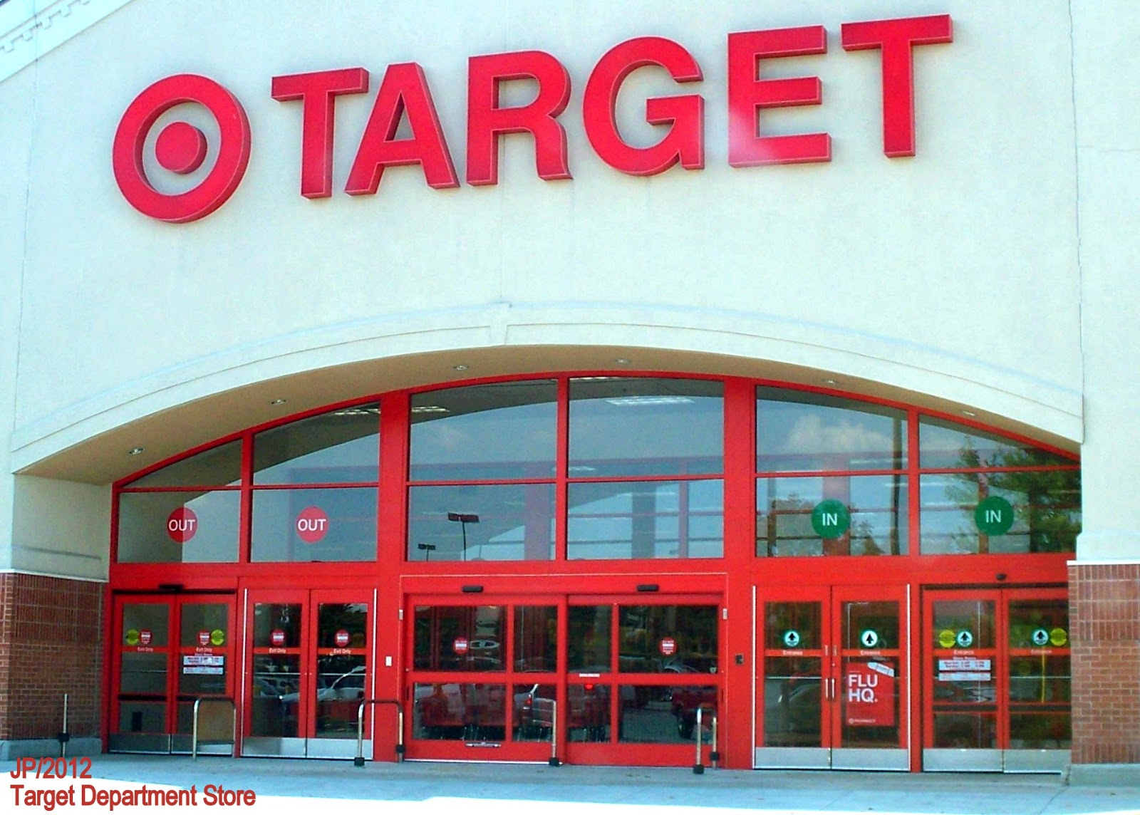
What is Data Science?
“How Companies Learn Your Secrets” NYT, by Charles Duhigg, February 16, 2012
http://bit.ly/targetdata

Slide 16
http://bit.ly/targetdata

Slide 17
What did Target Do?
Mining of data on shopping patterns
Specific products purchased
Combination of products purchased
Combined with demographic and other data
Psychology and neuroscience
Habits:
Cue-routine-reward
When are habits open to change?

Slide 18
Lessons from Target
Yes, Data Science is about mining data
There are deeper theoretical issues involved in understanding what you find
Left out of that long article are most of the critical steps that precede the analysis
In short, Data Science > data mining

Slide 19
Definition of Data Science
There are many, but most say data science is:
Broad – broader than any one existing discipline
Interdisciplinary: Computer Science, Statistics, Information Science, databases, mathematics
Applied focus on extracting knowledge from data to inform decision making.
Focuses on the skills needed to collect, manage, store, distribute, analyze, visualize, and reuse data.
There are many visual representations of Data Science

Slide 20
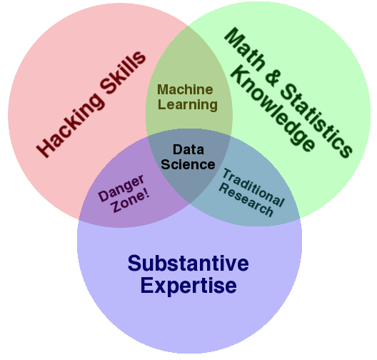
Some definitions link computational, statistical, and substantive expertise.

Slide 21
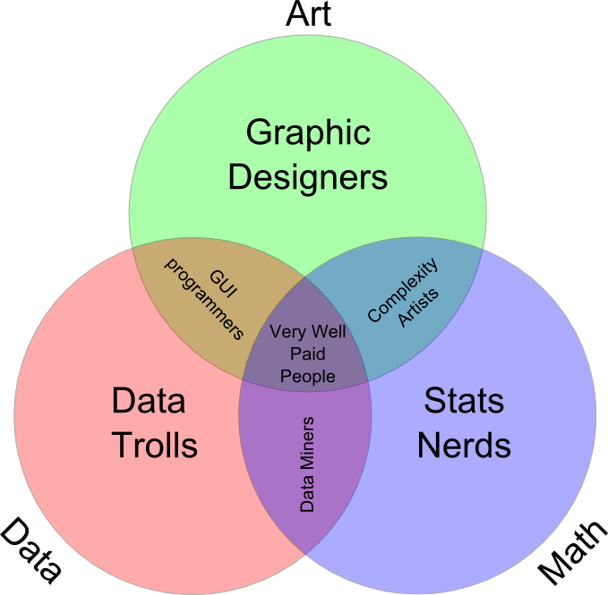
Other definitions focus more on technical skills alone.

Slide 22
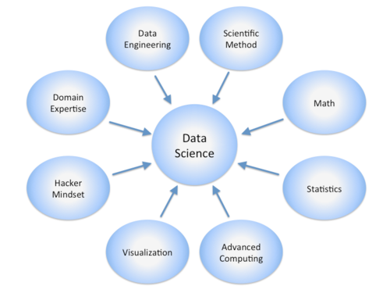
Still other definitions are so broad as to include nearly everything.

Slide 23
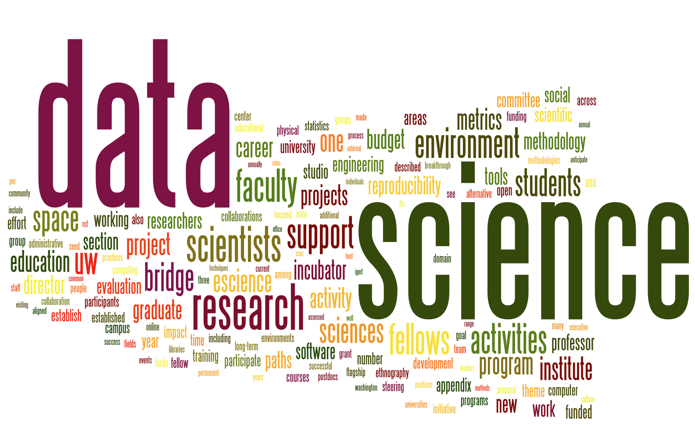
There are many “Word Cloud” representations of Data Science as well.

Slide 24
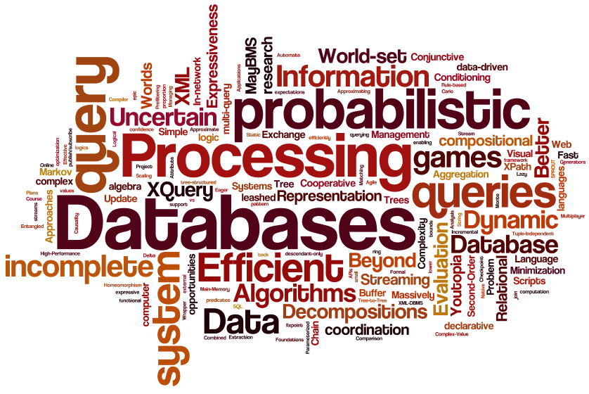

Slide 25
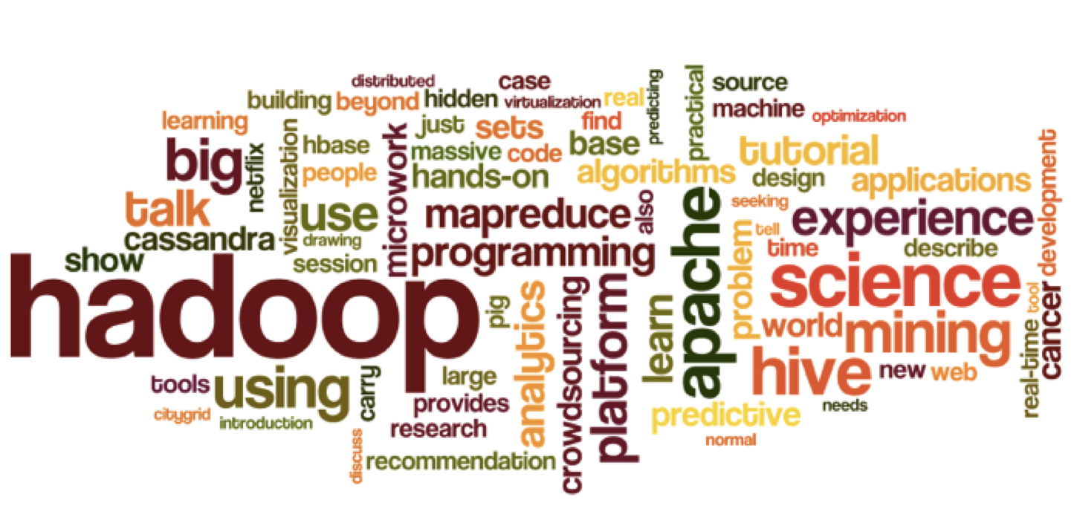

Slide 26
The Data Lifecycle
Data science considers data at every stage of what is called the data lifecycle.
This lifecycle generally refers to everything from collecting data to analyzing it to sharing it so others can re-analyze it.
New visions of this process in particular focus on integrating every action that creates, analyzes, or otherwise touches data.
These same new visions treat the process as dynamic – archives are not just digital shoe boxes under the bed.
There are many representations of the this lifecycle.

Slide 27
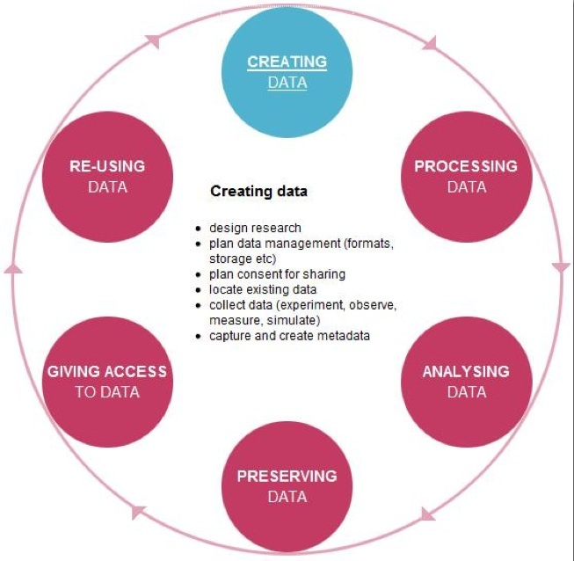

Slide 28
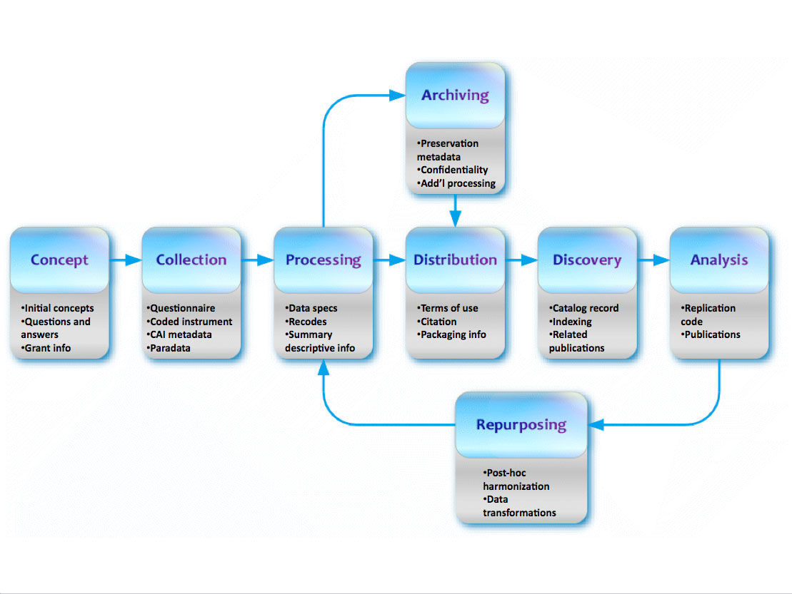

Slide 29
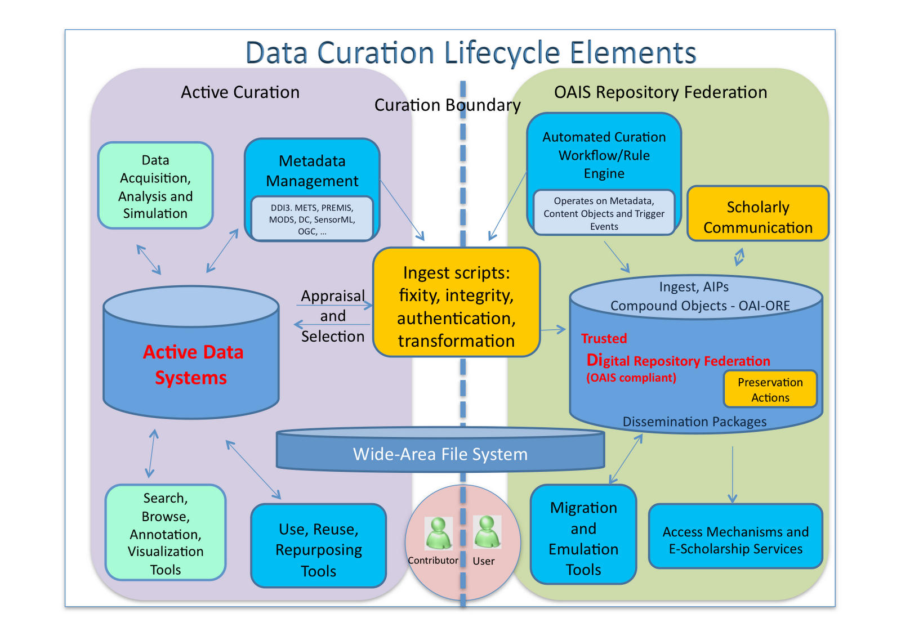

Slide 30
What is Missing?
Most definitions of data science underplay or leave out discussions of:
Substantive theory
Metadata
Privacy and Ethics

Slide 31
APPENDIX

Slide 32
What is the DGP?
Good analysis starts with a question you want to answer.
Blind data mining can only get you so far, and really, there is no such thing as completely blind mining
Answering that question requires laying out expectations of what you will find and explanations for those expectations.
Those expectations and explanations rest on assumptions
If your data collection, data management, and data analysis are not compatible with those assumptions, you risk producing meaningless or misleading answers

Slide 33
The DGP (cont.)
Think of the world you are interested in as governed by dynamic processes.
Those processes produce observable bits of information about themselves – data
We can use data analysis to:
Discover patterns in data and fit models to that data
Make predictions outside of our data
Inform explanations of both those patterns and those predictions.
Real discovery is NOT about modeling patterns in observable data. It is about understanding the processes that produced that data.

Slide 34
Theories and DGPs
Theories provide explanations for the processes we care about.
They answer the question, Why does something work the way it does.
Theories make predictions about what we should see in data.
We use data to test the predictions, but we never completely test a theory.

Slide 35
Why do we need theory?
Can’t we just find “truth” in the data if we have enough of it? Especially if we have all of it?
More data does not mean more representative data.
Every method of analysis make some assumptions, so we are better off if we make them explicit.
Patterns without understanding are a best uninformative and at worst deeply misleading.

Slide 36
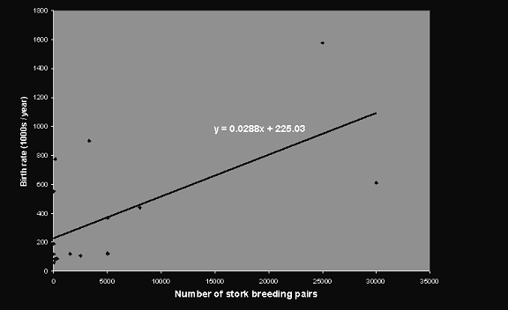
Robert Mathews Aston, 2000. “Storks Deliver Babies (P=0.008).”
Teaching Statistics. Volume 22, Number 2, Summer 2000

Slide 37
New Behaviors Require New Theories
The Target example illustrated how existing theories about habit formation informed their data mining efforts.
However, who new behaviors exist that are creating a lot of the data that data scientists want to analyze:
Online shopping
Cell phone usage
Crowd sourced recommendation systems
Facebook, Google searching, etc.
Online mobilization of social protests
We need new theories for these new behaviors.

Slide 38
Metadata
Metadata is data about data. It is frequently ignored or misunderstood.
Metadata is required to give data meaning.
It includes:
Variable names and labels, value labels, information on who collected the data, when, by what methods, in what locations, for what purpose, and by who.
Metadata is essential to use data effectively, to reuse data, to share data, and to integrate data.

Slide 39
Privacy and Ethics
Data, the elements of data science, and even so-called “Big Data” are not new.
One thing that is new is the greater variety of data and, most importantly, the amount of data available about humans.
Discussion and good policy regarding privacy, security, and the ethical use of data about people lags behind the methods of collecting, sharing, archiving, and analyzing data.
We will return to these issues later in the course.

Slide 40

The Free Market, Unfair Competition, Big Brother?

Slide 41
Big Data
The launch of the Data Science conversation has been sparked primarily by the so-called “Big Data” revolution.
As mentioned, we have always had data that taxed our technical and computational capacities.
“Big Data” makes front-page news, however, because of the explosion of data about people.
Contemporary definitions of Big Data focus on:
Volume (the amount of data)
Velocity (the speed of data in and out)
Variety (the diverse types of data)

Slide 42
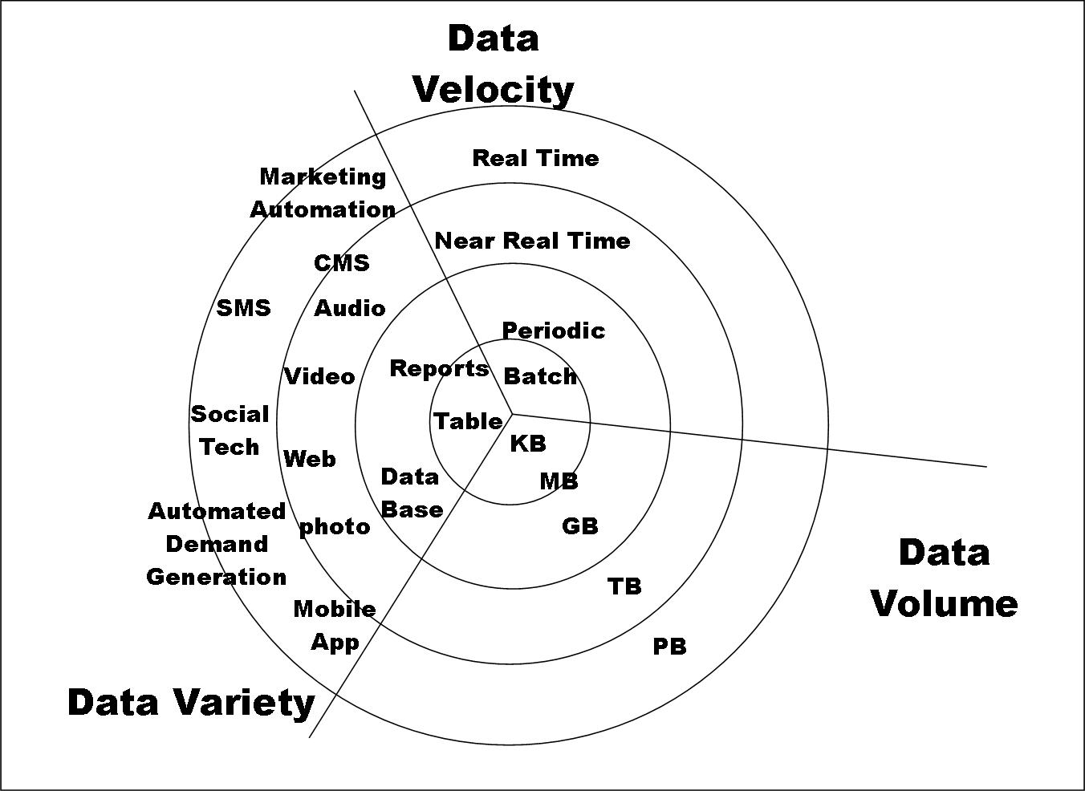

Slide 43
Big Data
Despite their linkage in many contemporary discussions, Big Data ≠ Data Science.
Data science principles apply to all data – big and small.
There is also the so-called “Long Tail” of data.

Slide 44
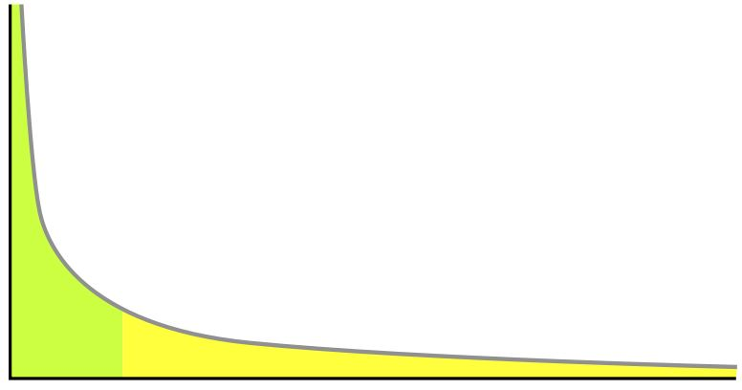
The Long Tail
Big Data
Most Data

Slide 45
Challenges of Big Data
Big Data does present some unique challenges.
Searching for average patterns may be better served by sampling
Searching rare events might require big data
Big haystacks (may) contain more needles.
The Long Tail data presents a challenge for integration across data sets.
The DataBridge Project
http://databridge.web.unc.edu/

Slide 46
Does Big = Good?
Lost in most discussions of Big Data is whether it is representative data or not.
We can mine Twitter, but who tweets?
We can mine health records, who whose records do we have?
We can track online purchasing, but what about off-line market behavior?
Survey research has spent decades worrying about representativeness, weighting, etc., but I do not see it discussed nearly as much in data science.

Slide 47
Theory, Methods, and Big Data
The greatest need for theory and the greatest challenges for computationally intensive methods arise:
When data is too small – there is not enough information in the data by itself.
When data is too big – the computational costs become too high
There is a “just right” that allows for complex models and computationally demanding methods to be used so that theoretical assumptions can be relaxed.

Slide 48
Data Science and Elections
The Obama campaigns in 2008 and 2012 are credited for their successful use of social media and data mining.
Micro-targeting in 2012
http://www.theatlantic.com/politics/archive/2012/04/the-creepiness-factor-how-obama-and-romney-are-getting-to-know-you/255499/
http://www.mediabizbloggers.com/group-m/How-Data-and-Micro-Targeting-Won-the-2012-Election-for-Obama---Antony-Young-Mindshare-North-America.html
Micro-profiles built from multiple sources accessed by aps, real-time updating data based on door-to-door visits, focused media buys, e-mails and Facebook messages highly targeted.
1 million people installed the Obama Facebook app that gave access to info on “friends”.

Slide 49
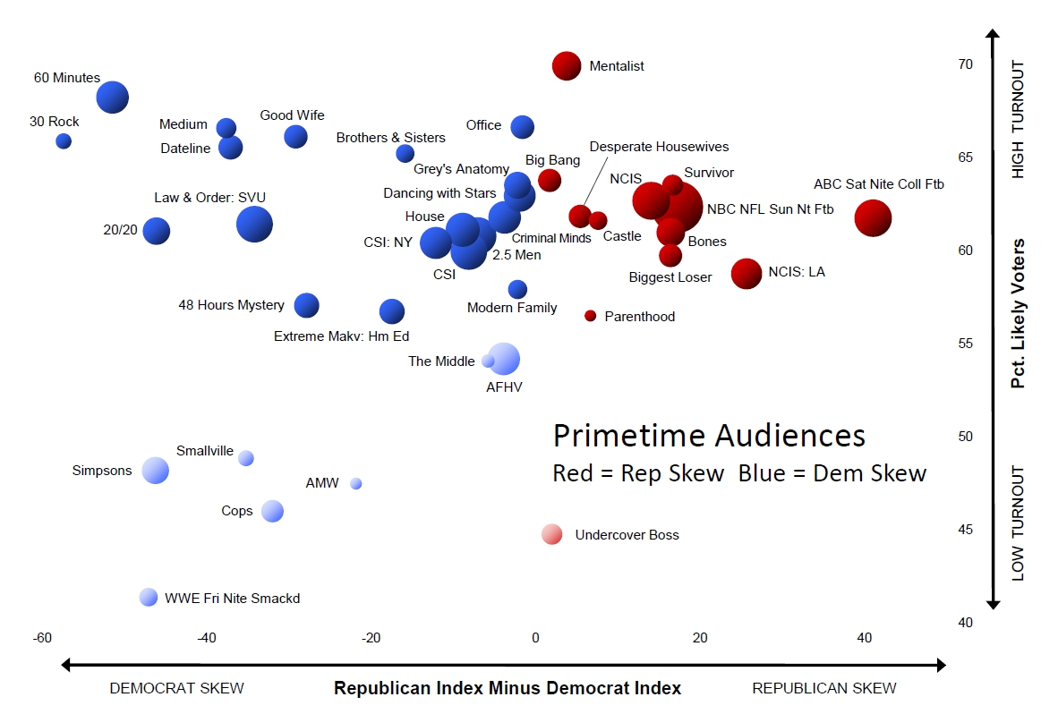
http://www.theatlantic.com/politics/archive/2012/04/
the-creepiness-factor-how-obama-and-romney-are-getting-to-know-you/255499/

Slide 50
Big Data and Politics: Something Old, Something New . . .
The massive data collection and micro-targeting regarding voters that defined 2012 is both:
New – that amount and diversity of data mobilized for near real time updating and analysis was unprecedented.
Old – it is a reversion to retail, door-to-door, personalized politics.
“All Politics is Local” – Tip O’Neill.

Slide 51
Initial Conclusions
Data Science is an evolving field
Exciting, confusing, immature
Data science will be critical in an information economy and to national security, but it is also changing our social behavior, the arts, and everything else.
There are many claims made about data science and “Big Data,” and some of them are probably true.
Focused on applied interaction between computer science, information science, and statistics.
This is good, but . . .
It needs to figure out how to include substantive expertise and theories.
It needs greater attention to privacy and ethics.

Slide 52
Data Collection
Data exist all around us
Government statistics
Prices on products
Surveys (polls, the Census, Business surveys, etc.)
Weather reports
Stock prices
Potential data is ubiquitous
Every action, attitude, behavior, opinion, physical attribute, etc. that you could imagine being measured.

Slide 53
The Roots of Data Science
Simple observation and recording those observations dates back to the most ancient civilizations
The Greeks were the first western civilization to adopt observation and measurement
Some call Aristotle the first empirical scientist
Muslim scholars between the 10th and 14th centuries developed experimentation (Haytham)
Roger Bacon (1214-1284) promoted inductive reasoning (inference)
Descartes (1596-1650) shifted focus to deductive reasoning.

Slide 54
Methods of Data Collection
Traditional Methods:
Observe and record
Interview, Survey
Experiment
Newer methods employ these techniques, but also include:
Remote observation (e.g. sensors, satellites)
Computer assisted interviewing
Biological and physiological measurement
Web scraping, digital path tracing
Crowd sourcing

Slide 55
Measurement is the Key
Regardless of how you collect data, you must consider measurement.
Measurement links an observable indicator, scale, or other metric to a concept of interest.
There is always some slippage in measurement
Basic types and concerns:
Nominal, Ordinal, Interval, Ratio
Dimensions, error, validity, reliability.

Slide 56
Validity and Reliability
Validity refers to how well the measure captures the concept.
Construct Validity
How well does the scale measure the construct it was intended to measure. (Correlations can be potential measures)
Content Validity:
Does the measure include everything it should and nothing that it should not? This is subjective (no statistical test here)
Criterion Validity
How well does the measure compare to other measures and/or predictors

Slide 57
Reliability
Reliability revers to whether a measure is consistent and stable.
Can the measure be confirmed by further measurement or observations?
If you measure the same thing with the same measurement tool, would you get the same score?

Slide 58
Why Measurement Matters
If the measurement of the outcome you care about has random error, your ability to model and predict it will decrease.
If the measurement of predictors of the outcome has random error, you will get biased estimates of how those predictors are related to the outcome you care about.
If either outcomes or predictors have systematic measurement error, you might get relationships right, but you’ll be wrong on levels.

Slide 59
Storing Collected Data
Once you collect data, you need to store it.
Flat “spreadsheet” like files
Relational data bases
Audio, Video, Text?
Numeric or non-Numeric?
Plan for adding more observations, more variables, or merging with other data sources

Slide 60
Data Analysis
We analyze data to extract meaning from it.
Virtually all data analysis focuses on data reduction
Data reduction comes in the form of:
Descriptive statistics
Measures of association
Graphical visualizations
The objective is to abstract from all of the data some feature or set of features that captures evidence of the process you are studying

Slide 61
Why Data Reduction?
Data reduction lets us see critical features or patterns in the data.
Which features are important depends on the question we are asking
Road maps, topographical maps, precinct maps, etc.
Much of data reduction in data science falls under the heading of statistics

Slide 62
Some Definitions
Data is what we observe and measure in the world around us
Statistics are calculations we produce that provide a quantitative summary of some attribute of data.
Cases/Observations are the objects n the world for which we have data.
Variables are the attributes of cases (or other features related to the cases) for which we have data.

Slide 63
Quantitative vs. Qualitative
Much of the “tension” between these two approaches is misguided.
Both are Data
Both are or can be:
Empirical
Scientific
Systematic
Wrong
Limited

Slide 64
Qual and Quant (cont.)
It is not as simple as Quant=numbers and Qual=words.
Much of quantitative data is merely categorization of underlying concepts
Countries are labeled “Democratic” or not
Kids are labeled “Gifted” or not
Couples are labeled “Committed” or “In Love” or not
Baseball players commit “Errors” or not
Different types of chocolate are “Good” or not
Increasing quantitative analysis of text

Slide 65
Goals of Statistical Analysis
Description offers an account or summary, but not an explanation of why something is the way it is.
Causality offers a statement about influence.
The “fundamental problem of causation”
A causal statement is NOT necessarily a theoretical statement: theory demands an explanation for why something happens.
Inference involves extrapolating from what you find in your data to those cases for which you do not have data.
It will always be probabilistic
We can have both Descriptive and Causal inferen

Slide 66
So what are Statistics?
Quantities we calculate to summarize data
Central tendency
Dispersion
Distributional characteristics
Associations and partial associations/correlation
Statistics are exact representations of data, but serve only as estimates of population characteristics. Those estimates always come with uncertainty.

Slide 67
Basic Data Analysis
The first step in any data analysis is to get familiar with the individual variables you will be exploring
I often tell my students that Table 1 of any paper or report should be a table of descriptive statistics
You want to look at the type of variable and how it is measured
You want to describe its location/central tendency
You want to describe its distribution
You can do these things numerically and graphically
We will explore this more in lab

Slide 68
Issues to Consider
Is the variable uni-modal or not?
Is the distribution symmetric or skewed?
Are there extreme values?
It the variable bound at one or both ends by construction?
Do observed values “make sense?”
How many observations are there?
Are any transformations appropriate?

Slide 69
Two More Problems
Do you have missing data? Missing at random or not?
You can:
Ignore it
Interpolate it
Impute it (multiple imputation)
Is “treatment” randomly assigned
You can:
Ignore it
Design an experiment
“Control” it statistically
“Control” it through matching (and the statistically).

Slide 70
Training and Testing
Before you start, you need to determine your goal:
Fitting the model to the data at hand
Fitting the model to data outside of your sample
These two goals are not the same, and in fact, they are generally in conflict.
Random chance will produce patterns in any one sample of data that are not representative of the DGP and, thus, would not be likely to appear in other samples of data.
Over-fitting a model to the data at hand WILL capitalize on those oddities within the one sample you have.

Slide 71
The Netflix Contest
In 2009, Netflix awarded a $1 million prize to anyone who could come up with a better movie recommending model.
Provided contestants (in 2006) with about:
100 million ratings from 480,000 customers of 18,000 movies.
Winners would be determined by which model best predicted 2.8 million ratings that they were NOT given (a bit more complex than this)
Why? To avoid over-fitting.

Slide 72
The Netflix Contest: The Sequel
There was to be a second contest, but it was stopped in part due to a lawsuit.
Though Netflix de-identified its data, researchers at Texas were able to match the data to other online moving ratings and were able to identify many individuals.

Slide 73
Training and Testing Data
We have two primary tools we can use to avoid over-fitting:
Having a theory to guide our research
Separating our data into Training and Testing subsets
This can be done at the outset, as we will see
This can also be done on a rolling basis through processes like K-fold cross-validation and Leave-one-out cross-validation.

Slide 74
Modeling Data
Once you are familiar with your data, you need to determine the question you want to ask.
The Question you want to ask will help determine the method you will use to answer it.

Slide 75
Types of Modeling Problems
Supervised Learning: You have some data where the outcome of interest is already known. Methods focus on recovering that outcome and prediction to new outcomes
Classification Problems
Scoring Problems (regression-based models)
Unsupervised learning: No outcome (yet) to model
Clustering (of cases – types of customers)
Association Rules (clusters of actions by cases – groups of products purchased together)
Nearest Neighbor Methods (actions by cases based on similar cases – you might buy what others who are similar to you bought)

Slide 76
Evaluating Model Performance
You need a standard for comparison. There are several:
Null Model:
Mean/Mode
Random
Bayes Rate Model (or saturated model):
Best possible model given data at hand
The Null and Saturated models set lower and upper bounds
Single Variable Model
More parsimonious that models relying on multiple variables.

Slide 77
More on Model Performance
Evaluating classification models:
Confusion Matrix: table mapping observed to predicted outcomes.
Accuracy: The number of items correctly classified divided by the number of total items.
Accuracy is not as helpful for unbalanced outcomes
Precision: the fraction of the items a classifier flags as being in a class that actually are in the class.
Recall: The fraction of things that actually are in a class that are detected as being so.
F1 measure: combination of Precision and Recall
(2 * precision * recall) / (precision + recall)

Slide 78
Model Performance (cont.)
Sensitivity: True Positive Rate (Exactly the same as recall)
The fraction of things in a category detected as being so by the model
Specificity: True Negative Rate
The fraction of things not in a category that are detected as not being so by the model
They mirror each other if categories of two-category outcome variables are flipped (Spam and Not Spam)
Null classifiers will always return a zero on either Sensitivity or Specificity

Slide 79
Evaluating Scoring Methods
Root Mean Squared Error:
Square root of average square of the differences between observed and predicted values of the outcome.
Same units as the outcome variable.
R-squared:
Absolute Error – not generally recommended as RMSE or just MSE recover aggregate results better.

Slide 80
Evaluating Probability Model Fit
Area under the Receiver operating characteristic (ROC) curve
Ranges between 1.0 and 0.5
Every possible tradeoff between sensitivity and specificity for a classifier
Log likelihood
Deviance
AIC/BIC
Entropy: measures uncertainty. Lower conditional entropy is good.

Slide 81
Evaluating Cluster Models
Avoiding:
“Hair” clusters – those with very few data points
“Waste” clusters – those with a large proportion of data points
Intra-cluster distance vs. cross-cluster distance.
Generate cluster labels and then use classifier methods to re-evaluate fit
Don’t use the outcome variable of interest in the clustering process (Spam vs. Not-spam)

Slide 82
Model Performance Final Thoughts
The worst possible outcome is NOT failing to find a a good model.
The worst possible outcome is thinking you have a good model when you really don’t.
Besides over-fitting and all of the other problems we’ve mentioned, another problem is endogeneity:
A situation where the outcome variable is actually a (partial) cause of one of your independent variables.

Slide 83
Memorization Methods
Methods that return the majority category or average value for the outcome variable for a subset of the training data.
We’ll focus on classifier models.

Slide 84
Single Variable Models
Tables
Pivot tables or contingency tables: just a cross-tabulation between the outcome and a single (categorical) predictor.
The goal is to see how well the predictor does at predicting categories of the outcome

Slide 85
Multi-variable models
Most of the time we still mean a single outcome variable, but using two or more independent variables to predict it.
Often called multivariate models, but this is wrong.
Multivariate really means more than one outcome (or dependent) variable, which generally means more than one statistical equation.
A key question is how to pick the variables to include.

Slide 86
Picking Independent Variables
Pick based on theory – always the best starting point
Pick based on availability – “the art of what is possible”
Pick based on performance
Establish some threshold
Consider basing this on “calibration” data set
Not training data – over-fitting
Not testing data – you must leave that alone for model evaluation, not model building.

Slide 87
Decision Trees
Decision trees make predictions that are piecewise constant.
The data is divided based on classes of the independent variables with the goal of predicting values of the outcome variable.
Multiple or all possible trees are considered
Partitioning ends – you hit leaves – when either all outcomes on the branch are identical or when further splitting does not improve prediction

Slide 88

A tree showing survival of passengers on the Titanic
("sibsp" is the number of spouses or siblings aboard).
The figures under the leaves show the probability of survival
and the percentage of observations in the leaf.

Slide 89
Nearest Neighbor Methods
Finds K training observations that are nearest to the observation then uses the average of their outcomes as the prediction for the observation in question.
Nearest can be defined multiple ways, but many rest on Euclidean distance so it is best to use independent variables that are continuous, nonduplicative and orthogonal to each other.
When outcomes are unbalanced, use a larger value for K, such as large enough to have a good chance of observing 10 rare outcomes.
K ≈ 10/prob(rare)

Slide 90
Naïve Bayes
Considers how each variable is related to the outcome and then makes predictions by multiplying together the effects of each variable.
Similar to constructing a series of single variable models.
Assumes that the independent variables are independent of each other.
Often outperformed by logit or Support Vector Machines.

Slide 91
Regression Models
Regression models predict a feature of a dependent or outcome variable as a function of one or more independent or predictor variables.
Independent variables are connected to the outcome by coefficients/parameters.
Regression models focus on estimating those parameters and associated measures of uncertainty about them.
Parameters combine with independent variables to generate predictions for the dependent variable.
Model performance is based in part on those predictions.

Slide 92
Flavors of Regression
There are multiple flavors of regression, but most fit under these headings:
Linear Model
Generalized Linear Models
Nonlinear Model

Slide 93
Linear Regression
The most common model is the linear regression model.
It is often what people mean when they just say “regression.”
It is by far most frequently estimated via Ordinary Least Squares, or OLS.
Minimizes the sum of the squared errors.
Models the expected mean of Y given values of X and parameters that are estimated from the data.
Y_{i} = β₀ + β₁(X_{i}) + ε_{i}

Slide 95
Assumptions of OLS
Model Correctly Specified
No measurement error
Observations on Y_{i}, conditional on the model, are Independently and Identically Distributed (iid)
For hypothesis testing – the error term is normally distributed.
We don’t have time to review all of this now, but if questions come up, please ask.

Slide 96
Prediction
Parameter estimates capture the average expected change in Y for a one-unit change in X, controlling for the effects of other X’s in the model.
Once you have parameter estimates, you can combine them with the training data (the data used to estimate them) or any other data with the same independent variables, and generate predicted values for the outcome variable.
Model performance is often based on the closeness of those predictions.

Slide 97
Linear Regression
Widely use, simple, and robust.
Not as good if you have a large number of independent variables or independent variables that consist of many unordered categories.
Good at prediction when independent variables are correlated, but attribution of unique effects is less certain.
Multiple assumptions to check.
Linearity being the most central to correct model specification.
Can be influenced by outliers
Median Regression is an alternative.

Slide 98
Logistic Regression
Logistic regression, or logit, is at the heart of many classifier algorithms
It is similar to linear regression in that the right hand side of the model is an additive function of independent variables multiplied by (estimated) parameters.
However, that linear predictor is then transformed to a probability bounded by 0 and 1 that is used to predict which of two categories (0 or 1) the dependent variable falls into.

Slide 99
Logistic Regression
The logit model is one of a class of models that fall under the heading of Generalized Linear Models (GLMs).
Parameters are nearly always estimated via Maximum Likelihood Estimation
OLS is a special case of MLE
Parameters that minimize the sum of squared errors also maximize the likelihood function.
MLE is an approximation method and you can have problems with convergence.

Slide 100
Logit (cont.)
Much of what makes OLS good or bad for modeling a continuous outcome makes logit good or bad for modeling a dichotomous outcome.
You cannot directly interpret the coefficients from a logit model.
The number e raised to the value of the parameter gives the factor change in the odds
More common to compute changes in predicted probabilities.
Note that these are nonlinear.
You can have non-convergence from separation
Predictions that are too good/perfect

